Slide 1

Introduction to Random Graph

Slide 2
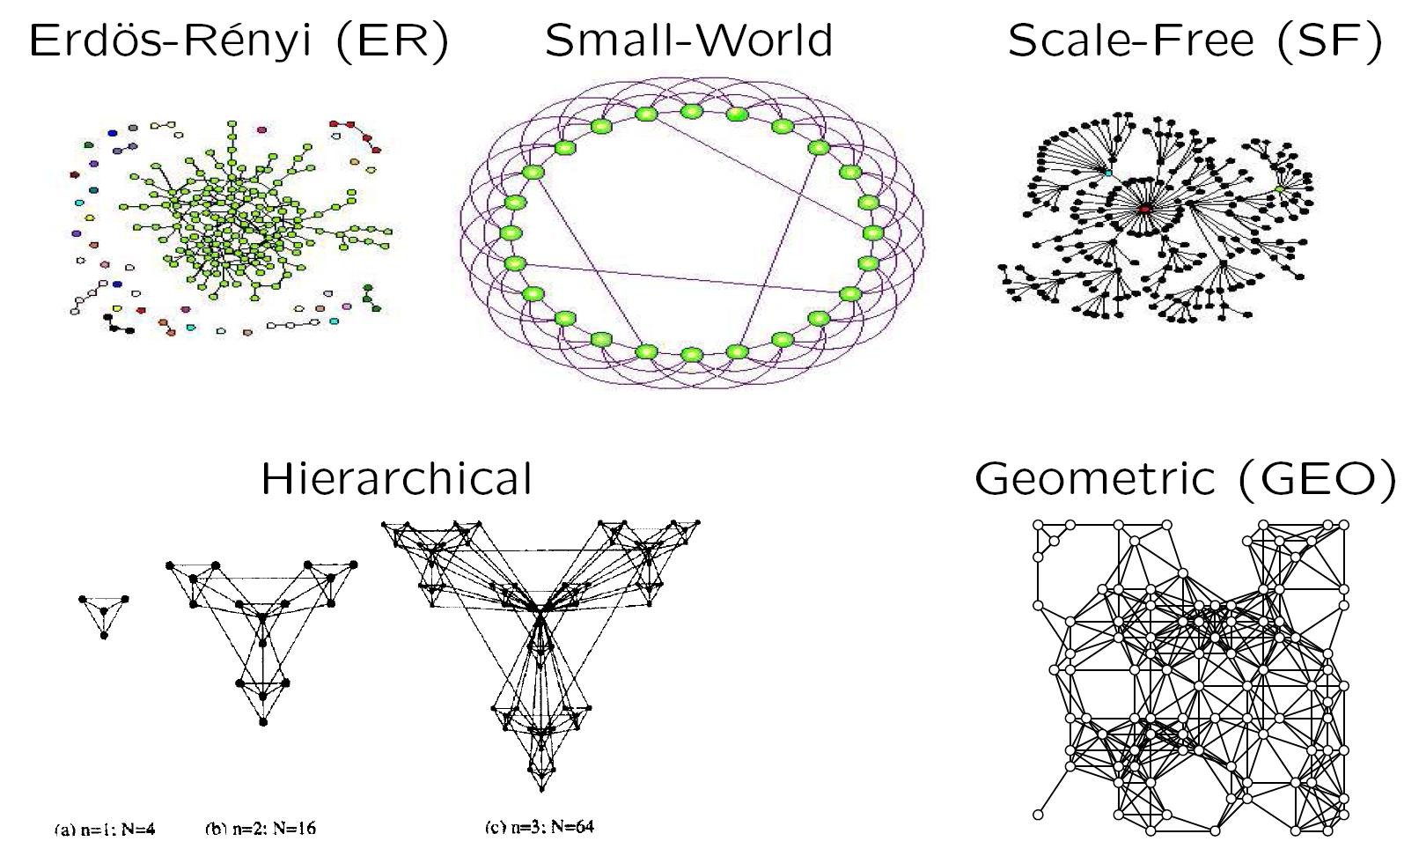
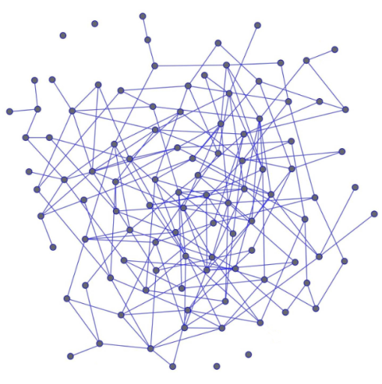
What is a network (graph) model?

Slide 3
Network models
We will cover the following network models:
Erdos–Renyi random graphs
Small-world networks
Scale-free networks
Generalized random graphs (with the same degree distribution as the data networks)
Hierarchical model
Geometric random graphs

Slide 4
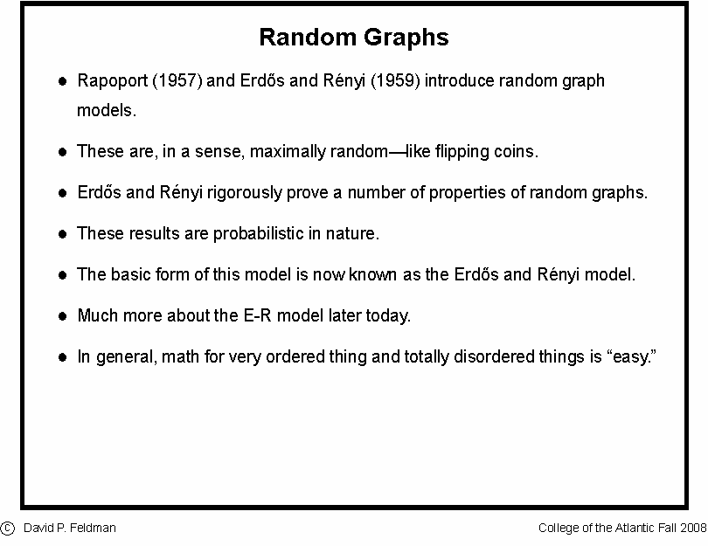
Random Graph: An insight within

Slide 5
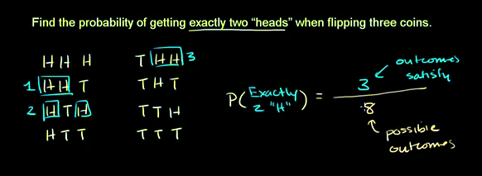
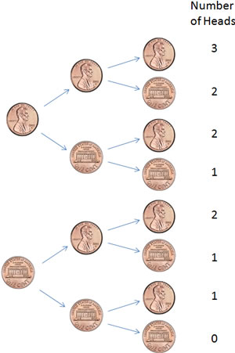

Random graph: Preliminaries (Flipping a coin)
Probability of getting exactly 2 heads when flipping 3 coins P(2) =
×
p²(1 − p)²
Khan Academy

Slide 6


Random Graph: An insight within
Pál Erdös
(1913-1996)
Alfréd Rényi
(1921-1970)
Construction
Erdös-Rényi model (1960)
Connect with probability p
p=1/6 N=10
⟨k⟩ ~ 1.5
Total number of connections =
Possible number of connections with probability 1/6
=
Network Science: Random Graphs 2012
Barabasi Group ppt

Slide 7
Erdos–Renyi random graphs (ER)
Construction

Slide 8

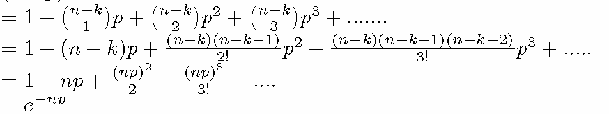

Random graph: Preliminaries
(Binomial distribution and Poisson distribution)
The probability of getting exactly k successes in n trials is given
by the probability mass function:
k = 0, 1, 2, ..., n
-
For large n
if n is sufficiently large and p is sufficiently small.
known as the Poisson distribution

Slide 9
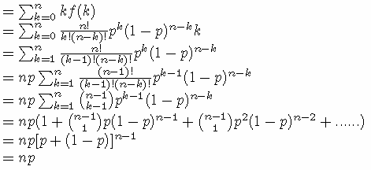

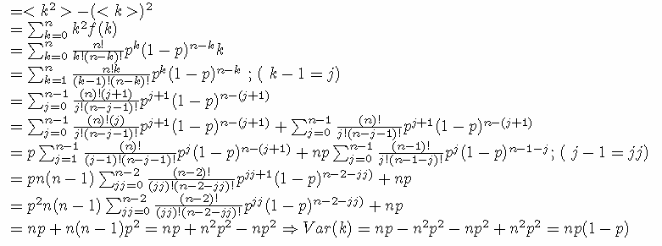
Random graph: Preliminaries
(Binomial distribution and Poisson distribution)
Mean/expectation value
=
Variance

Slide 10
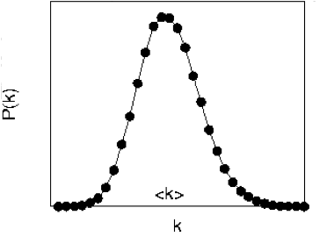
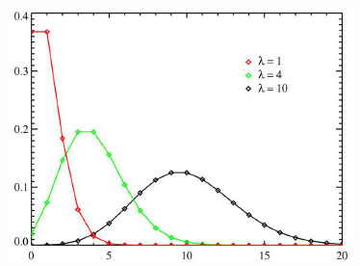


Random graph: Preliminaries
(Binomial distribution and Poisson distribution)
Binomial distribution
Expectation/Mean
Variance
Poisson distribution
k

Slide 11
Properties of Random Network
Select k
nodes from N-1
probability of missing N-1-k edges
probability of
having k edges
Network Science: Random Grapha`s 2012

Slide 12
Properties of Random Network

Slide 13
Properties of Random Network

Slide 14
Random Graph: An insight within
In the G(n, M) model, a graph is chosen uniformly at random from the collection of all graphs which have n nodes and M edges.
In the G(n, p) model, a graph is constructed by connecting nodes randomly. Each edge is included in the graph with probability p independent from every other edge.
Construction
A
A
A
B
C
B
C
B
C
wiki
Notes:
For example, in the G(3, 2) model, each of the three possible graphs on three vertices and two edges are included with probability 1/3.

Slide 15
Erdos–Renyi random graphs (ER)
Model a network G(V,E) with |V|=n and |E|=m
An ER graph that models G is constructed as follows:
  It has n nodes
  Edges are added between pairs of nodes uniformly at random with the same probability p
  Two (equivalent) methods for constructing ER graphs:
    G_{N,p}: pick p so that the resulting model network has m edges
    G_{N,m}: pick randomly m pairs of nodes and add edges between them with probability 1
    Q: When they are “same”?

Slide 16
Erdos–Renyi random graphs (ER)

Slide 18
Percolation process: emergence of giant component

Slide 19

Giant Component
A network component whose size grows in proportion to $n$ is called giant component
Let $u$ be the fraction of nodes that do not belong to the giant component. Hence,
  If there is no giant component → $u=1$
  If there is giant component → $u<1$
In order for a node $i$ not to connect to the giant component:
  $i$ needs not connect to any other node $j→1−p$
  $i$ is connected to $j$, but $j$ itself is not connected to the giant component $→ pu$

Slide 20

Giant Component
Hence, the total probability of $i$ not being connected to giant component via vertex j is: $1−p+pu$
  Considering all $n−1$ vertices through which i can connect:
  Taking the logarithms at both sides and the Taylor approximation for large n:
  This equation cannot be solved in close form

Slide 21

Giant Component
We plot $y=1−e−cS$with $S$ between 0 and 1 (since it represents fraction of nodes)
We also plot $y=S$
The point where the two curves intersect is the solution
For small c only one solution
  $S=0$
For greater c there might be two
solutions
  The point where two solutions start
  appearing is when the gradients of the two
  curves are equal at $S=0$
    This happens for $c=1$

Slide 22


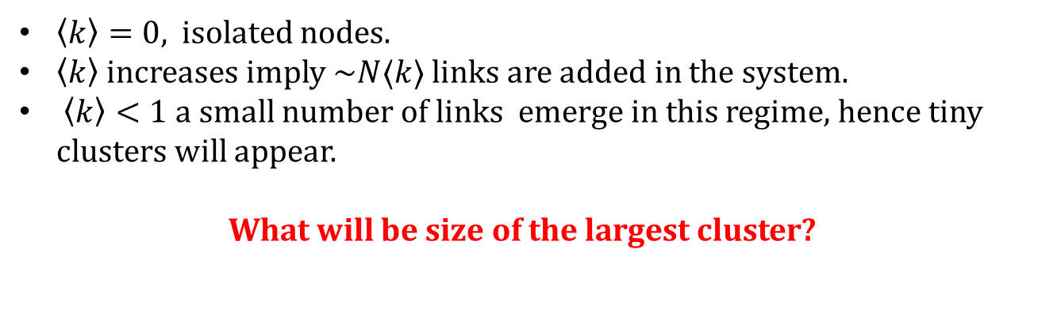
Properties of Random Network
Sub critical Regime ($0<\left\langle k\right\rangle <1$) ($p<\frac{1}{N}$)
$\left\langle k\right\rangle =0,$ isolated nodes.
$\left\langle k\right\rangle$ increases imply ~$N⟨k⟩$ links are added in the system.
$\left\langle k\right\rangle <1$ a small number of links emerge in this regime, hence tiny clusters will appear.
What will be size of the largest cluster?
$$O(log⁡(N)).$$
wiki

Slide 23
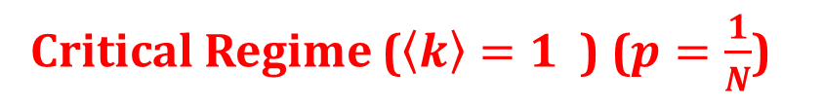

Properties of Random Network
Critical Regime ($\left\langle k\right\rangle =1$) ($p=\frac{1}{N}$)
What will be the size of the largest cluster?
$$N2/3$$
Relative size is still zero. However there will be a significant jump in largest magnitude of the largest cluster.
Different size of cluster coexist (from power law)
Giant components will have loops
Small components are still tree
wiki

Slide 24
Properties of Random Network
Super critical Regime ($\left\langle k\right\rangle >1$) ($p>\frac{1}{N}$)
At critical
What will be the size of the largest cluster? (size of N)
The further we move from the critical point, the larger fraction of nodes will belong to it.
In the supercritical regime, numerous isolated components coexist with the giant component
These small components are trees, while the giant component contains loops and cycles. The supercritical regime lasts until the giant component absorbs all nodes.
wiki

Slide 25

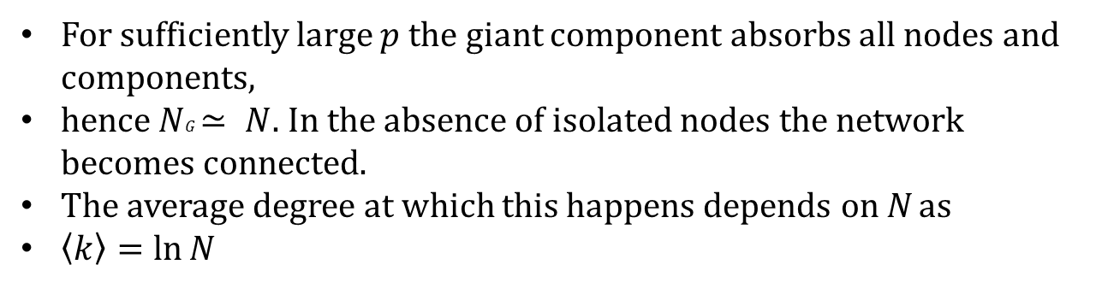
Properties of Random Network
Connected Regime ($\left\langle k\right\rangle >ln(N)$) ($p>\frac{ln(N)}{N}$)
For sufficiently large $p$ the giant component absorbs all nodes and components,
hence $NG≃ N$. In the absence of isolated nodes the network becomes connected.
The average degree at which this happens depends on N as
$\left\langle k\right\rangle =\ln{N}$
In summary, the random network model predicts that the emergence of a network is not a smooth, gradual process: The isolated nodes and tiny components observed for small <k> collapse into a giant component through a phase transition
wiki

Slide 27
Simulate the system for n=500

Slide 29
Properties of Random Network
wiki

Slide 30
Properties of Random Network
Connected Regime ($\left\langle k\right\rangle >ln(N)$) ($p>\frac{ln(N)}{N}$)
For sufficiently large $p$ the giant component absorbs all nodes and components,
hence $NG≃ N$. In the absence of isolated nodes the network becomes connected.
The average degree at which this happens depends on N as
$\left\langle k\right\rangle =\ln{N}$
In summary, the random network model predicts that the emergence of a network is not a smooth, gradual process: The isolated nodes and tiny components observed for small <k> collapse into a giant component through a phase transition
wiki

Slide 31

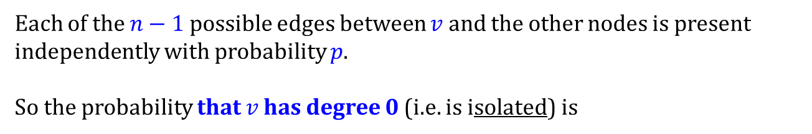
Properties of Random Network (ER): Isolated nodes
Each of the $n−1$possible edges between $v$ and the other nodes is present independently with probability $p$.
So the probability that $v$ has degree 0 (i.e. is isolated) is
$$Pr⁡(v is isolated)={\left(1−p\right)}^{n−1}.$$
This is simply the probability every one of those $n−1$edges is absent.

Slide 32
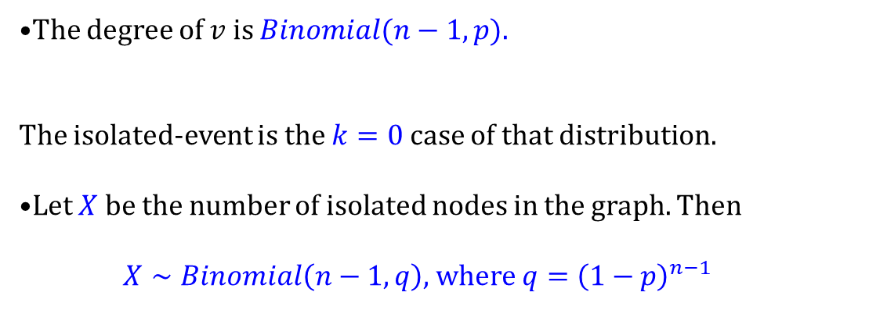
Properties of Random Network (ER): Isolated nodes
$$Pr⁡(v is isolated)={\left(1−p\right)}^{n−1}.$$
The degree of $v$ is $Binomial(n−1,p).$
The isolated-event is the $k=0$case of that distribution.
Let $X$ be the number of isolated nodes in the graph. Then
$X∼Binomial\left(n−1,q\right),$ where ${q=\left(1−p\right)}^{n−1}$

Slide 33
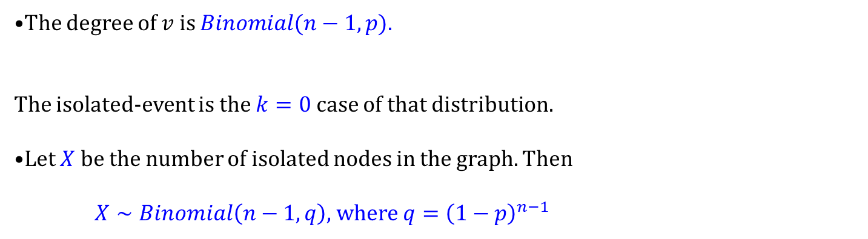
Properties of Random Network (ER): Isolated nodes
$$Pr⁡(v is isolated)={\left(1−p\right)}^{n−1}.$$
The degree of $v$ is $Binomial(n−1,p).$
The isolated-event is the $k=0$case of that distribution.
Let $X$ be the number of isolated nodes in the graph. Then
$X∼Binomial\left(n−1,q\right),$ where ${q=\left(1−p\right)}^{n−1}$
Thus, $E\left(X\right)=\left(n−1\right)q$ and $Var\left(X\right)=nq(1−q)$

Slide 34
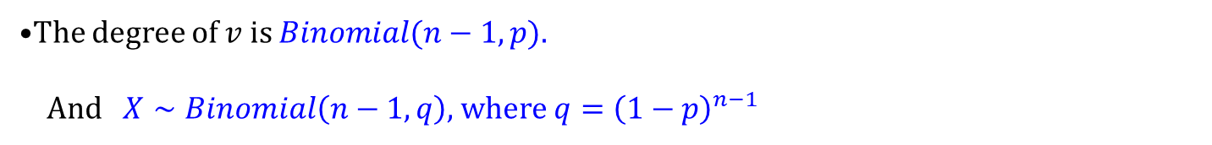
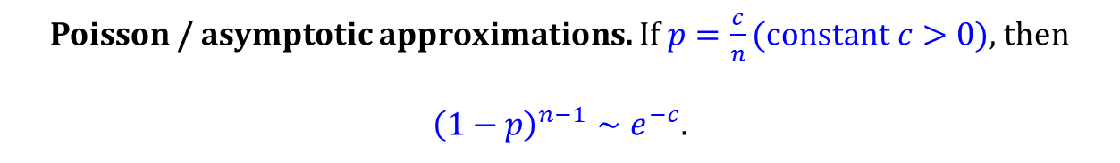
Properties of Random Network (ER): Isolated nodes
$$Pr⁡(v is isolated)={\left(1−p\right)}^{n−1}.$$
The degree of $v$ is $Binomial(n−1,p).$
And $X∼Binomial\left(n−1,q\right),$ where ${q=\left(1−p\right)}^{n−1}$
Thus, $E\left(X\right)=\left(n−1\right)q$ and $Var\left(X\right)=nq(1−q)$
Poisson / asymptotic approximations. If $p=\frac{c}{n}(constant c>0)$, then
${\left(1−p\right)}^{n−1}∼e^{−c}$.

Slide 35

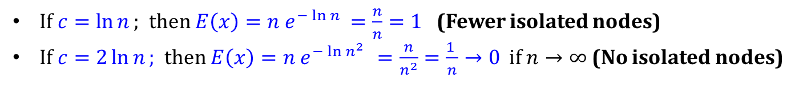


Properties of Random Network (ER): Isolated nodes
$$Pr⁡(v is isolated)={\left(1−p\right)}^{n−1}.$$
The degree of $v$ is $Binomial(n−1,p).$
And $X∼Binomial\left(n−1,q\right),$ where ${q=\left(1−p\right)}^{n−1}$
Thus, $E\left(X\right)=\left(n−1\right)q$ and $Var\left(X\right)=nq(1−q)$
Poisson / asymptotic approximations. If $p=\frac{c}{n}(constant c>0)$, then
${\left(1−p\right)}^{n−1}∼e^{−c}$.
Then, $E\left(X\right)=n{\left(1−p\right)}^{n−1}≈n e^{−c}=n e^{−np}$
If $c=\ln{n};$then $E\left(x\right)=n e^{−\ln{n }}=\frac{n}{n}=1$ (Fewer isolated nodes)
If $c=2\ln{n};$then $E\left(x\right)=n e^{−\ln{n^{2} }}=\frac{n}{n^{2}}=\frac{1 }{n}→0$ if $n→∞$ (No isolated nodes)

Slide 36

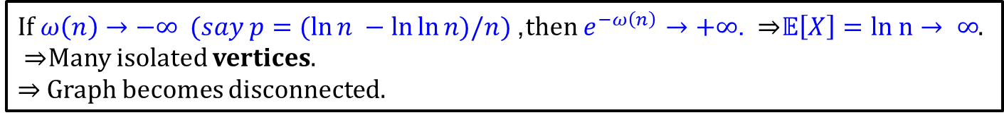

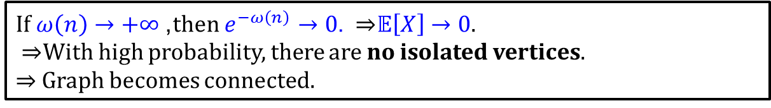
Properties of Random Network (ER): Isolated nodes
Insert $p=\frac{\ln{n}+ω\left(n\right)}{n}$
$$E\left(X\right)≈n e^{−c}=n e^{−np}$$
Here $ω\left(n\right)$is any function that grows slowly or quickly, but tends to infinity as $n→∞$ (e.g., $\log{log}{n}$, $\sqrt{\log{n}}$, etc.).
$E\left(X\right)=n e^{−np}=n e^{−n\frac{\ln{n}+ω\left(n\right)}{n}}=n e^{−(\ln{n+w (n))}}=e^{−w(n)}$
If $ω\left(n\right)→+∞$, then $e^{−ω\left(n\right)}→0$. ⇒ $𝔼\left[X\right]→0$.
⇒ With high probability, there are no isolated vertices.
⇒ Graph becomes connected.
If $ω\left(n\right)→−∞ (say p=(ln{n −\ln{\ln{n)/n}}})$, then $e^{−ω\left(n\right)}→+∞$. ⇒ $𝔼\left[X\right]=ln n→ ∞$.
⇒ Many isolated vertices.
⇒ Graph becomes disconnected.

Slide 37
Simulate the system for n=500

Slide 38
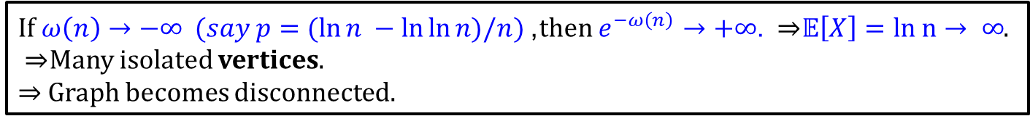

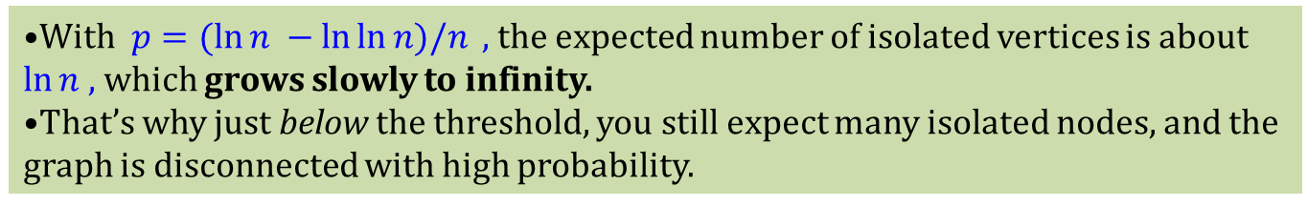
Properties of Random Network (ER): Isolated nodes
If $ω\left(n\right)→+∞$, then $e^{−ω\left(n\right)}→0$. ⇒ $𝔼\left[X\right]→0$.
⇒ With high probability, there are no isolated vertices.
⇒ Graph becomes connected.
If $ω\left(n\right)→−∞ (say p=(ln{n −\ln{\ln{n)/n}}})$, then $e^{−ω\left(n\right)}→+∞$. ⇒ $𝔼\left[X\right]=ln n→ ∞$.
⇒ Many isolated vertices.
⇒ Graph becomes disconnected.
With $p=(ln{n −\ln{\ln{n)/n}}} ,$the expected number of isolated vertices is about $\ln{n }$, which grows slowly to infinity.
That’s why just below the threshold, you still expect many isolated nodes, and the graph is disconnected with high probability.

Slide 40
INPUT: n (number of nodes),
numTrials (number of simulations per p),
pRange (list of edge probabilities)
FOR each p in pRange:
theoryIso = n * (1 - p)^(n - 1) # theoretical expectation
simSum = 0
FOR trial = 1 to numTrials:
# Generate random graph G(n,p)
A = empty adjacency matrix (n x n)
FOR each pair of vertices (i,j), i<j:
add edge with probability p
set A[i,j] = A[j,i] = 1 if edge present, else 0
END
# Count isolated vertices
degrees = row sums of A
isoCount = count of vertices with degree = 0
simSum += isoCount
END
simIso = simSum / numTrials # average isolated nodes
STORE (p, theoryIso, simIso)
END
# Plot
Plot theoryIso vs p as a smooth line
Plot simIso vs p as points
Draw vertical line at p = log(n)/n (connectivity threshold)
Label axes and legend

Slide 41
Properties of Random Network (ER):
Expected Local Clustering Coefficient

Slide 42
Properties of Random Network (ER):
Expected Local Clustering Coefficient

Slide 43
Properties of Random Network (ER):
Expected Local Clustering Coefficient

Slide 44
Simulate the system for n=500

Slide 45
Properties of Random Network (ER):
Expected Local Clustering Coefficient

Slide 46
Properties of Random Network (ER):
Expected Global Clustering Coefficient (Transitivity)

Slide 47
Properties of Random Network (ER):
Expected Global Clustering Coefficient (Transitivity)

Slide 48
Properties of Random Network (ER):
Expected Global Clustering Coefficient (Transitivity)
So the expected global clustering (transitivity) is also $p$ , with exact cancellation in the algebra.

Slide 51
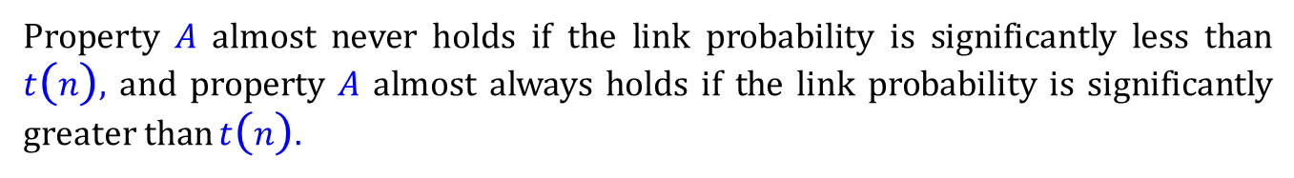
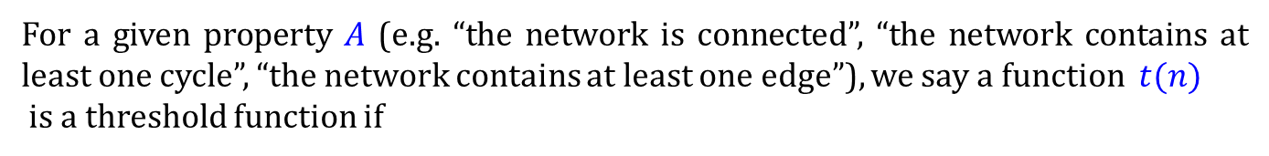

Properties of Random Network (ER): Asymptotic Properties
For a given property $A$ (e.g. “the network is connected”, “the network contains at least one cycle”, “the network contains at least one edge”), we say a function $t(n)$
is a threshold function if
$$P\left(A\right)→ 0 if\lim_{n→∞}{\frac{p\left(n\right)}{t\left(n\right)}}= 0, and$$
$P\left(A\right)→ 1 if$ $\lim_{n→∞}{\frac{p\left(n\right)}{t\left(n\right)}}=∞.$
Property $A$ almost never holds if the link probability is significantly less than $t(n)$, and property $A$ almost always holds if the link probability is significantly greater than $t(n).$
Alexander Wolitzky
MIT
6.207/14.15: Networks, Spring 2022

Slide 52
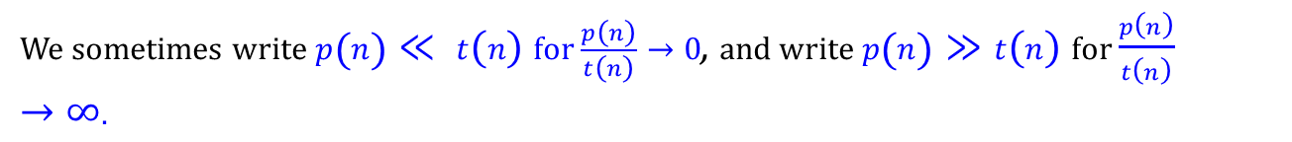
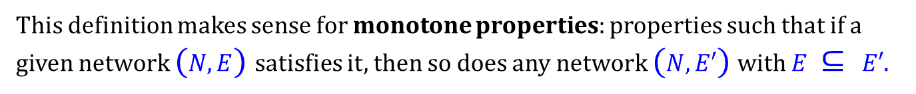
Properties of Random Network (ER): Asymptotic Properties
For a given property $A$ (e.g. “the network is connected”, “the network contains at least one cycle”, “the network contains at least one edge”), we say a function $t(n)$
is a threshold function if
$$P\left(A\right)→ 0 if\lim_{n→∞}{\frac{p\left(n\right)}{t\left(n\right)}}= 0, and$$
$P\left(A\right)→ 1 if$ $\lim_{n→∞}{\frac{p\left(n\right)}{t\left(n\right)}}=∞.$
We sometimes write $p\left(n\right)≪ t(n)$for $\frac{p\left(n\right)}{t\left(n\right)}→0$, and write $p\left(n\right)≫t(n)$for $\frac{p\left(n\right)}{t\left(n\right)}→∞.$
This definition makes sense for monotone properties: properties such that if a given network $(N, E)$satisfies it, then so does any network $(N, E′)$with $E ⊆ E′$.
Alexander Wolitzky
MIT
6.207/14.15: Networks, Spring 2022

Slide 53
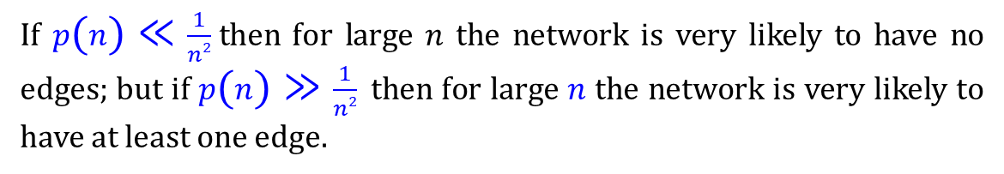
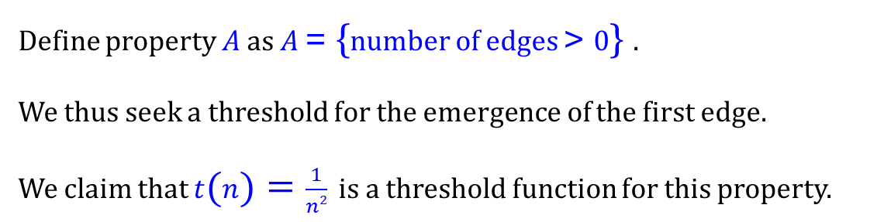
Properties of Random Network (ER): Asymptotic Properties
Define property $A$ as $A$ = {number of edges > 0} .
We thus seek a threshold for the emergence of the first edge.
We claim that $t\left(n\right)=\frac{1}{n2}$ is a threshold function for this property.
If $p\left(n\right)≪\frac{1}{n2}$ then for large $n$ the network is very likely to have no edges; but if $p\left(n\right)≫\frac{1}{n2}$ then for large $n$ the network is very likely to have at least one edge.
Alexander Wolitzky
MIT
6.207/14.15: Networks, Spring 2022

Slide 54
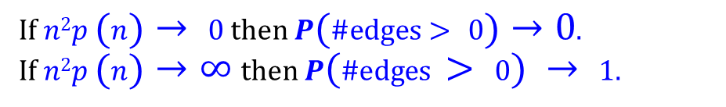
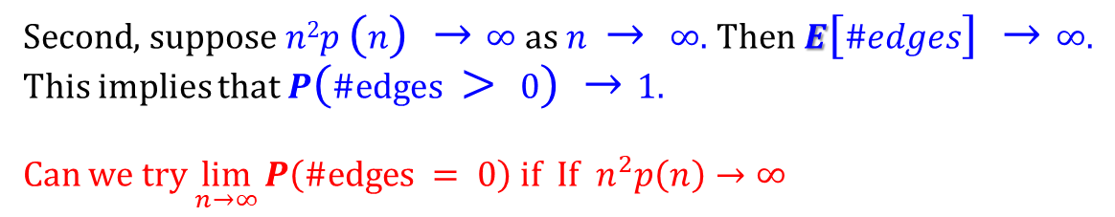
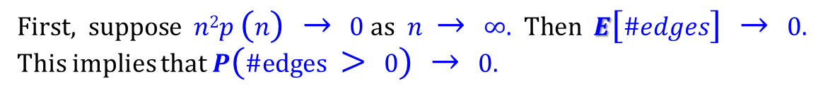
Properties of Random Network (ER): Asymptotic Properties
Statement
If $n2p \left(n\right)→ 0$then $P\left(\#edges> 0\right)→0$.
If $n2p \left(n\right)→∞$then $P(\#edges > 0) → 1.$
Proof
Recall that $E\left[\#edges\right]= \frac{n\left(n−1\right)}{2} p \left(n\right)≈\frac{n^{2}}{2} p\left(n\right)$
First, suppose $n2p (n) → 0$as $n → ∞$. Then $E[\#edges] → 0$. This implies that $P(\#edges > 0) → 0.$
Second, suppose $n2p (n) →∞$as $n → ∞$. Then $E[\#edges] →∞$. This implies that $P(\#edges > 0) →1.$
Can we try $\lim_{n→∞}{P\left(\#edges = 0\right)}$ if $If n^{2}p\left(n\right)→∞$
Alexander Wolitzky
MIT
6.207/14.15: Networks, Spring 2022

Slide 55

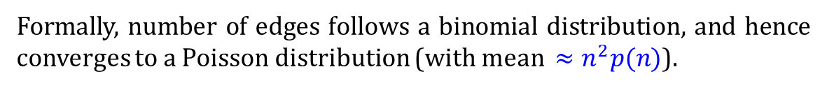
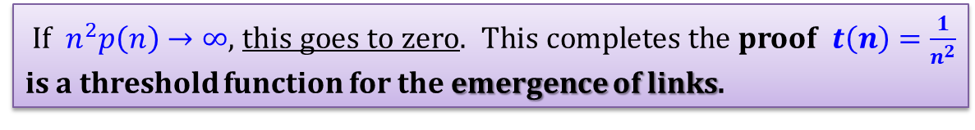
Properties of Random Network (ER): Asymptotic Properties
Proof
Recall that edge formation is independent, so by the law of large numbers the distribution of edges is tightly concentrated around its mean.
Formally, number of edges follows a binomial distribution, and hence converges to a Poisson distribution (with mean $≈n^{2}p(n)$).
$\lim_{n→∞}{P\left(\#edges = 0\right)}=\lim_{ n→∞}\frac{e^{− \frac{n^{2}}{2} p\left(n\right) {\left(\frac{n^{2}}{2} p\left(n\right)\right)}^{k}}}{k!}{}$
$$(k=0)$$
$$= \lim_{n→∞ }{e^{− \frac{n^{2}}{2} p\left(n\right) }}$$
$If n^{2}p\left(n\right)→∞$, this goes to zero. This completes the proof $t\left(n\right)=\frac{1}{n^{2}}$ is a threshold function for the emergence of links.
Alexander Wolitzky
MIT
6.207/14.15: Networks, Spring 2022

Slide 56
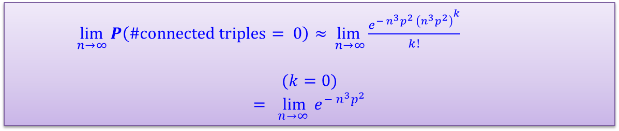
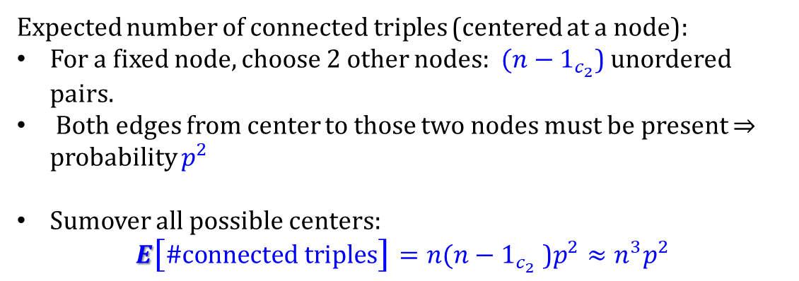
Properties of Random Network (ER): Asymptotic Properties
What is a threshold function for the emergence of connected triples?
Expected number of connected triples (centered at a node):
For a fixed node, choose 2 other nodes: ${(n−1}_{c_{2}}$) unordered pairs.
Both edges from center to those two nodes must be present $⇒$ probability $p^{2}$
Sumover all possible centers:
$$E\left[\#connected triples\right]=n{(n−1}_{c_{2}} \text{)}p^{2}≈n^{3}p^{2}$$
$\lim_{n→∞}{P\left(\#connected triples= 0\right)}≈\lim_{ n→∞}\frac{e^{− n^{3}p^{2} {\left(n^{3}p^{2}\right)}^{k}}}{k!}{}$
$$(k=0)$$
$$= \lim_{n→∞ }{e^{− n^{3}p^{2}}}$$
Alexander Wolitzky
MIT
6.207/14.15: Networks, Spring 2022

Slide 57
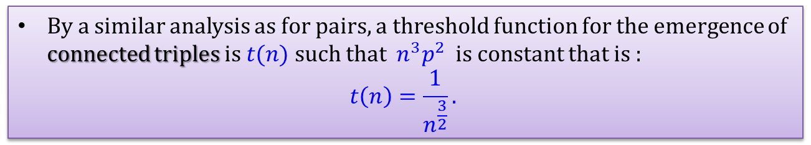
Properties of Random Network (ER): Asymptotic Properties
What is a threshold function for the emergence of connected triples?
Expected number of connected triples (centered at a node):
For a fixed node, choose 2 other nodes: ${(n−1}_{c_{2}}$) unordered pairs.
Both edges from center to those two nodes must be present $⇒$ probability $p^{2}$
Sumover all possible centers:
$$E\left[\#connected triples\right]=n{(n−1}_{c_{2}} \text{)}p^{2}≈n^{3}p^{2}$$
By a similar analysis as for pairs, a threshold function for the emergence of connected triples is $t(n)$such that $n^{3}p^{2}$ is constant that is :
$$t\left(n\right)=\frac{1}{n^{\frac{3}{2}}}.$$
Alexander Wolitzky
MIT
6.207/14.15: Networks, Spring 2022

Slide 58

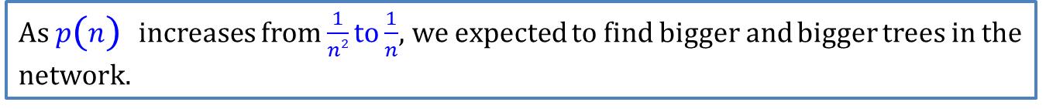
Properties of Random Network (ER): Asymptotic Properties
What is a threshold function for the emergence of tress with $k$ nodes?
$$E\left[\#k nodes trees\right]≈n^{k}p^{k−1}$$
So a threshold function is $t\left(n\right)=\frac{1}{n^{\frac{k}{k−1}}}$
As $p\left(n\right)$increases from $\frac{1}{n2}$to $\frac{1}{n}$, we expected to find bigger and bigger trees in the network.
Alexander Wolitzky
MIT
6.207/14.15: Networks, Spring 2022

Slide 59
Properties of Random Network (ER): Asymptotic Properties
What is a threshold function for the emergence of a cycle with $k$ nodes?
$$E\left[\#k nodes cycles\right]≈?$$
Alexander Wolitzky
MIT
6.207/14.15: Networks, Spring 2022

Slide 60
Properties of Random Network (ER): Asymptotic Properties
Alexander Wolitzky
MIT
6.207/14.15: Networks, Spring 2022

Slide 61
Simulation

Slide 62
Properties of Random Network
wiki

Slide 63
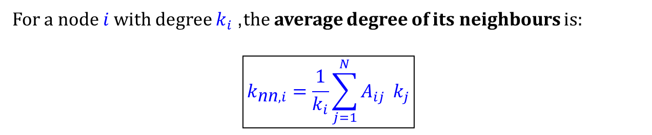
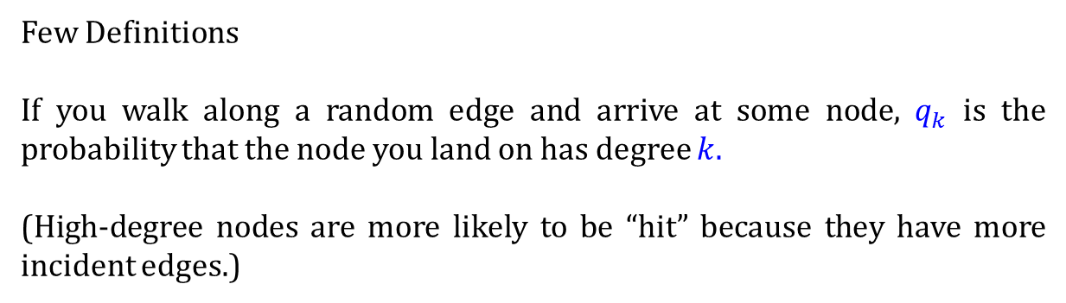
Average nearest neighbor
Few Definitions
If you walk along a random edge and arrive at some node, $q_{k}$ is the probability that the node you land on has degree $k$.
(High-degree nodes are more likely to be “hit” because they have more incident edges.)
For a node $i$ with degree $k_{i}$, the average degree of its neighbours is:
$$\boxed{k_{\text{nn},i}=\frac{1}{k_{i}}\sum_{j=1}^{N}{A_{ij}} k_{j}}$$

Slide 64
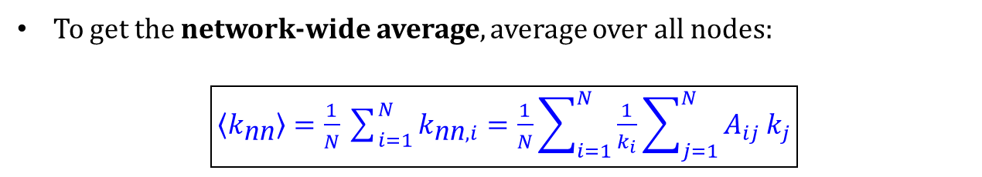


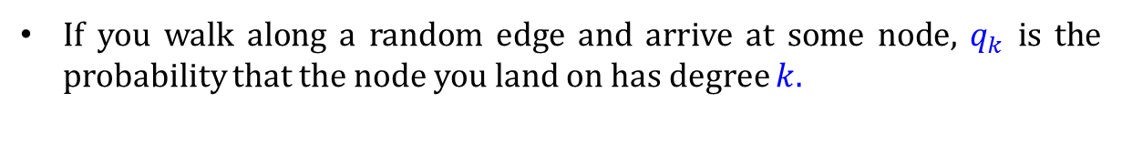
Average nearest neighbor
If you walk along a random edge and arrive at some node, $q_{k}$ is the probability that the node you land on has degree $k$.
For a node $i$ with degree $k_{i}$, the average degree of its neighbours is:
$$\boxed{k_{\text{nn},i}=\frac{1}{k_{i}}\sum_{j=1}^{N}{A_{ij}} k_{j}}$$
To get the network-wide average, average over all nodes:
$\boxed{\left\langle k_{\text{nn}}\right\rangle =\frac{1}{N}\sum_{i=1}^{N}{k_{\text{nn},i}}=\frac{1}{N}\sum_{i=1}^{N}{\frac{1}{k_{i}}}\sum_{j=1}^{N}{A_{ij}}k_{j}}$
This gives the expected degree of a neighbour of a randomly chosen node.
Clearly $\left\langle k_{nn}\right\rangle ≠⟨k⟩$

Slide 65
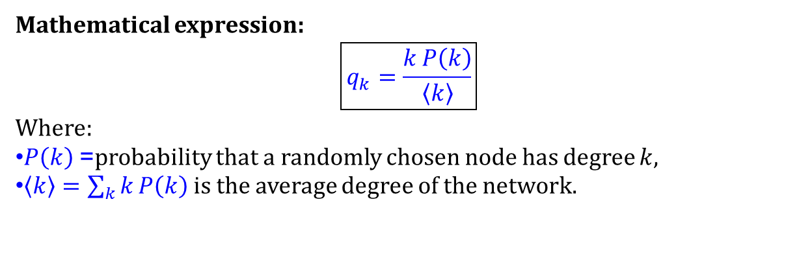
Average nearest neighbor
If you walk along a random edge and arrive at some node, $q_{k}$ is the probability that the node you land on has degree $k$.
Mathematical expression:
$$\boxed{q_{k}=\frac{k P\left(k\right)}{\left\langle k\right\rangle }}$$
Where:
$P\left(k\right)$= probability that a randomly chosen node has degree $k$,
$\left\langle k\right\rangle =\sum_{k}{k}P\left(k\right)$ is the average degree of the network.

Slide 66
Average nearest neighbor

Slide 67
Average nearest neighbor

Slide 69
Average nearest neighbor

Slide 70
Average nearest neighbor

Slide 73
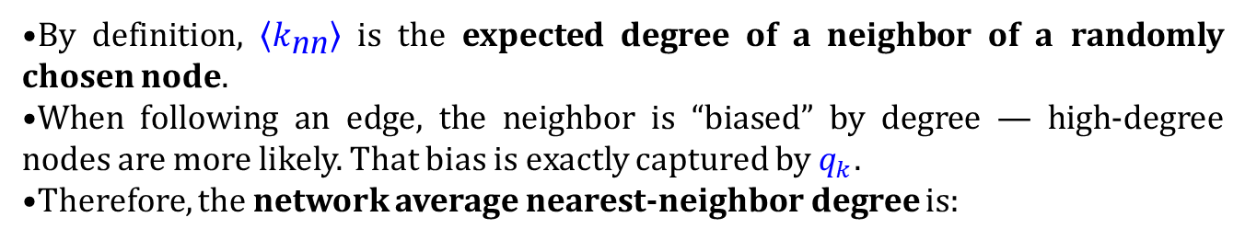
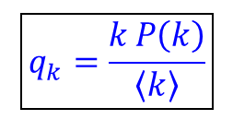

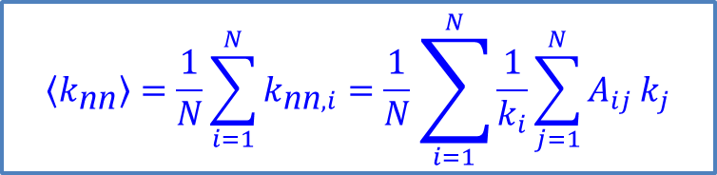
Average nearest neighbor
$$\left\langle k_{\text{nn}}\right\rangle =\frac{1}{N}\sum_{i=1}^{N}{k_{\text{nn},i}}=\frac{1}{N}\sum_{i=1}^{N}{\frac{1}{k_{i}}}\sum_{j=1}^{N}{A_{ij}}k_{j}$$
$$\boxed{q_{k}=\frac{k P\left(k\right)}{\left\langle k\right\rangle }}$$
By definition, $\left\langle k_{\text{nn}}\right\rangle$is the expected degree of a neighbor of a randomly chosen node.
When following an edge, the neighbor is “biased” by degree — high-degree nodes are more likely. That bias is exactly captured by $q_{k}$.
Therefore, the network average nearest-neighbor degree is:
$$\left\langle k_{nn}\right\rangle = \sum_{k=0}^{∞}{k q_{k}}$$
​$=\frac{1}{\left\langle k\right\rangle }\sum_{k=0}^{∞}{k^{2} P(k)}$
$$=\frac{\left\langle k^{2}\right\rangle }{⟨k⟩}$$

Slide 75


Average nearest neighbor
$$\left\langle k_{\text{nn}}\right\rangle =\frac{1}{N}\sum_{i=1}^{N}{k_{\text{nn},i}}=\frac{1}{N}\sum_{i=1}^{N}{\frac{1}{k_{i}}}\sum_{j=1}^{N}{A_{ij}}k_{j}$$
$$\boxed{q_{k}=\frac{k P\left(k\right)}{\left\langle k\right\rangle }}$$
$$\left\langle k_{nn}\right\rangle = \sum_{k=0}^{∞}{k q_{k}}$$
​$=\frac{1}{\left\langle k\right\rangle }\sum_{k=0}^{∞}{k^{2} P(k)}$
$$=\frac{\left\langle k^{2}\right\rangle }{⟨k⟩}$$
$q_{k}$ encodes the degree bias when following edges.
Multiplying $k. q_{k}$and summing over $k$ gives the expected degree of neighbors — exactly $\left\langle k_{nn}\right\rangle$.
This explains why in uncorrelated networks like ER, $\left\langle k_{nn}\right\rangle$is independent of the node you start from.

Slide 76


Slide 78


Slide 81
Average pathlength
ALBERT-LÁSZLÓ BARABÁSI

Slide 82
Average pathlength
(1)
Eqn. 1
ALBERT-LÁSZLÓ BARABÁSI

Slide 83



Average pathlength
Eqn. 1
Therefore, the diameter of a random network follows
$$d_{max}⁡=\frac{\ln{N }}{\ln{⟨k⟩}}$$
Actually, we can write,
$$\left\langle d\right\rangle =\frac{\ln{N }}{\ln{⟨k⟩}}.$$
As derived, it predicts the scaling of the network diameter, $dmax$, with the size of the system, $N$. Yet, for most networks the equation offers a better approximation to the average distance between two randomly chosen nodes, $⟨d⟩,$than to $dmax.$This is because $dmax$ is often dominated by a few extreme paths, while $\left\langle d\right\rangle ,$ is averaged over all node pairs, a process that suppresses the fluctuations.
ALBERT-LÁSZLÓ BARABÁSI

Slide 84



Average pathlength
The dependence of $⟨d⟩ on lnN$implies that the distances in a random network are orders of magnitude smaller than the size of the network. Consequently, by small in the "small world phenomenon" we mean that the average path length or the diameter depends logarithmically on the system size. Hence, “small” means that $⟨d⟩$is proportional to$lnN$, rather than $N$ or some power of $N$.
The $\frac{1}{\ln{⟨k⟩}}$term implies that the denser the network, the smaller is the distance between the nodes.
$$\left\langle d\right\rangle =\frac{\ln{N }}{\ln{⟨k⟩}}.$$
ALBERT-LÁSZLÓ BARABÁSI

Slide 85

Average pathlength
$$\left\langle d\right\rangle =\frac{\ln{N }}{\ln{⟨k⟩}}.$$
ALBERT-LÁSZLÓ BARABÁSI

Slide 86
Advanced Topics

Slide 87
Small Components
The giant component of a random graph typically fills up a very large portion of the graph vertices but not 100% of them
How are the rest of the nodes connected?
  Many small components whose average size is constant with the size of the network
Let us first show that there can be only one giant component in a G(n,p) graph → all other components are non-giant (i.e., small)

Slide 88
Small Components
Let us assume that there are two or more giant components
  Consider two of them, each with S₁n and S₂n nodes
  There are S₁nS₂n=S₁S₂n² pairs (i,j) where i belongs to the first giant component and j to the second
In order for the two components to be separate there should not be an edge between them. This happens with probability:

Slide 89

Small Components
Again, taking the logarithm in both sides and letting $n$ become large we get:
  The first term is constant if c is constant as $n$ increases
  Hence, the probability of the two components being separated decreases exponentially with $n$
From this it follows that there is only one giant component in a random graph and since this does not contain all the vertices of the graph, there should be small components as well

Slide 90
Small components
Small Components
π_{s} is the probability that a randomly chosen vertex belongs to a small component of size s in total:
In order to calculate the above probability we will make use of the fact that small components are trees
  Consider a small component of size s that forms a tree
    There are s-1 edges in total
  If we add one more edge there will be a loop
    Number of new edges possible:
    Considering the probability of existence for these edges
      The total number of extra edges in the component is
Why not 1?
Notes:
Because some vertices will not belong to any small component – but to the giant one.

Slide 91
Small Components
Since a small component is tree any vertex i (with degree k) in the component is the “connection” of k sub-graphs in the same component
  The component size is equal to the sum of the subgraphs i’s vertices lead to (plus 1 – node i)
Assume now we remove vertex i from the network
  For large network this does not really change any of the statistical properties of the network (cavity method)
  In this graph the previous sub-graphs are the components themselves

Slide 92
Small Components
Therefore, the probability that neighbor n₁ belongs to a component of size s₁ is itself π_{s1}
The probability P(s|k) that vertix i belongs to a small component of size s, given that its degree is k, is given by the probability that its k neighbors belong to components with sizes that sum up to s-1 (in the new cavity network):
We remove the condition using the degree distribution of the random graph:

Slide 93
Small Components
The previous equation is difficult to compute due to the Kronecker delta
A trick that is often used in such situations is that of generating function or z-transform
  Polynomial function or series in z whose coefficients are the probabilities π_{s}
  Given function h we can then recover the probabilities as:

Slide 94
Small Components
In our case, substituting the probabilities at the z-transform we get:

Slide 95
Small Components
The previous equation still does not have a closed form solution for h(z), however we can use it to calculate some interesting quantities
The mean size of the component a randomly chosen vertex belongs is given by:
Computing the derivative of h(z) from the previous equation we finally get:

Slide 96
Small Components
When c < 1, there is no giant component:
When c > 1, we first need to solve for S and then substitute to find <s>
Note that for c = 1, we have a divergence
  Small components get larger as we increase c from 0 to 1
  They diverge when the giant component appears (c=1)
  They become smaller as the giant component gets larger (c>1)
Notes:
Although random graph is not realistic, the behavior of small components is similar to what happens in many real-world networks
If a network has low edge density there are many small components. As the density increases (larger average degree) → a giant component emerges

Slide 97
Properties of Random Network
wiki

